Slide 1
CCS3101
OBJECT-ORIENTED PROGRAMMING Topic 6 File Management

Slide 2
Learning Objectives
At the end of this chapter, you should be able to:
Solve programming problems using input/output classes (P4, A3)

Slide 3
The File Class
The File class is intended to provide an abstraction that deals with most of the machine-dependent complexities of files and path names in a machine-independent fashion. The filename is a string. The File class is a wrapper class for the file name and its directory path.

Slide 4
The File class
Create File object
Syntax:
java.io.File fileObject = new java.io.File(filename);
Example:
java.io.File file = new java.io.File(“score.txt”);
Check whether file already created or not
Syntax:
file.exists()
Example:
while (file.exists()) {
}
Delete the file (will return true if the deletion succeed)
if (file.delete())
System.out.println(“File deleted”);

Slide 5
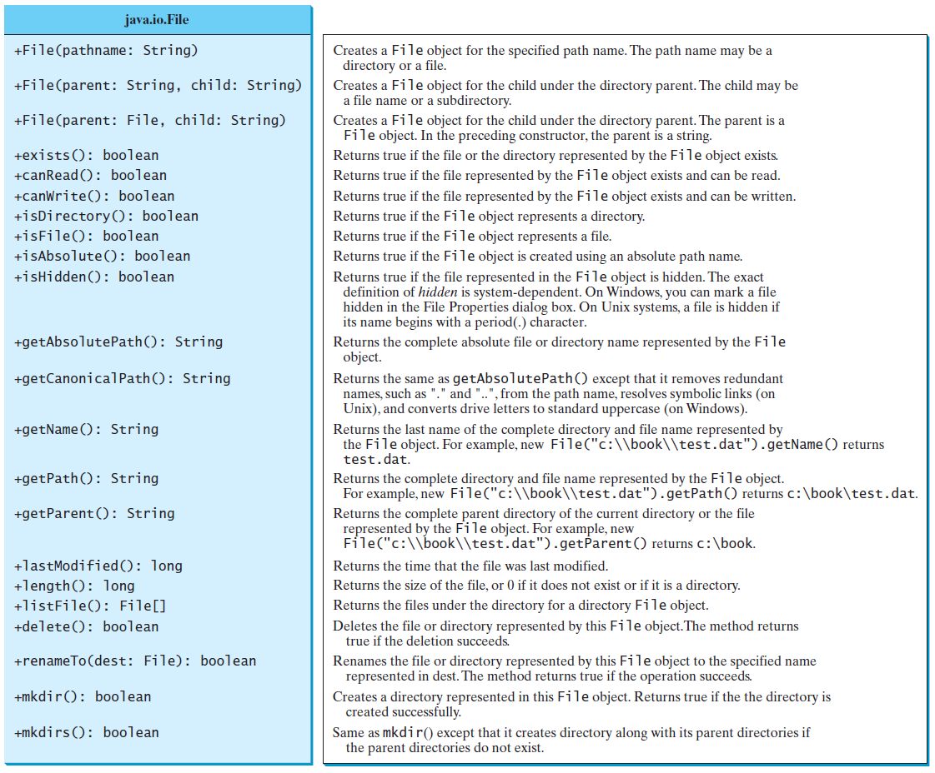
Obtaining file properties and manipulating file

Slide 6
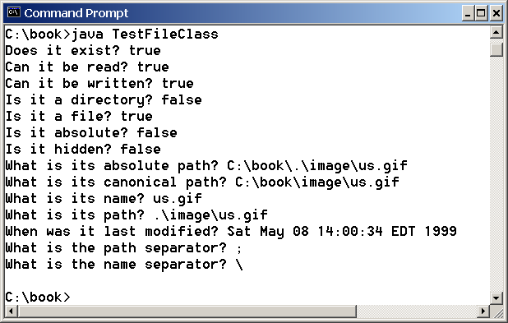
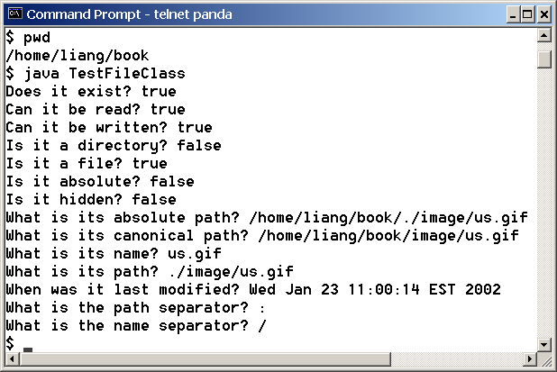
Problem: Explore File Properties
Objective: Write a program that demonstrates how to create files in a platform-independent way and use the methods in the File class to obtain their properties. The following figures show a sample run of the program on Windows and on Unix.
TestFileClass
Run

Slide 7
Text I/O
A File object encapsulates the properties of a file or a path, but does not contain the methods for reading/writing data from/to a file. In order to perform I/O, you need to create objects using appropriate Java I/O classes. The objects contain the methods for reading/writing data from/to a file. This section introduces how to read/write strings and numeric values from/to a text file using the Scanner and PrintWriter classes.

Slide 8
Writing to a Text File
Class PrintWriter is the preferred stream class for writing to a text file.
PrinterWriter has methods print and println.
Create a stream to associate the output stream with the file
java.io.File file = new java.io.File(“score.txt”);
PrintWriter output = new PrintWriter(file);

Slide 9
Writing Data Using PrintWriter
WriteData
Run

Slide 10
import java.io.*;
import java.util.*;
public class WriteDataToFile{
public static void main(String[] args) throws Exception{
String fname="phonebook.txt";
File file = new File(fname);
if(file.exists()){
System.out.println("File "+fname+" already exists");
System.exit(0);
}
// Create a file
PrintWriter output = new PrintWriter(file);
// Write formatted output to the file
output.printf("%-15s %-15s\n","Name","Phone Number");
output.printf("%-15s %-15s\n","Ah Chong","012-2121669");
output.printf("%-15s %-15s\n","Ahmad Jais","016-21634340");
output.close();
}
}

Slide 11
Try-with-resources
Programmers often forget to close the file. JDK 7 provides the followings new try-with-resources syntax that automatically closes the files.
try (declare and create resources) {
Use the resource to process the file;
}
WriteDataWithAutoClose
Run

Slide 12
Reading from a Text File
Class Scanner
Replace the argument System.in with suitable stream that is connected to the text file.
Scanner input = new Scanner (file);
or
Scanner input = new Scanner ( new java.io.File("scores.txt"));

Slide 13
Throw FileNotFoundException if the file is failed to open. (you need to import java.io.FileNotFoundException)
Scanner input = null;
try {
input = new Scanner(file);
}
catch (FileNotFoundException e) {
System.out.println(file + " not found");
System.exit(0);
}

Slide 14
Reading Data Using Scanner
ReadData
Run

Slide 15
Problem: Replacing Text
Write a class named ReplaceText that replaces a string in a text file with a new string. The filename and strings are passed as command-line arguments as follows:
java ReplaceText sourceFile targetFile oldString newString
For example, invoking
java ReplaceText FormatString.java t.txt StringBuilder StringBuffer
replaces all the occurrences of StringBuilder by StringBuffer in FormatString.java and saves the new file in t.txt.
ReplaceText
Run

Slide 16
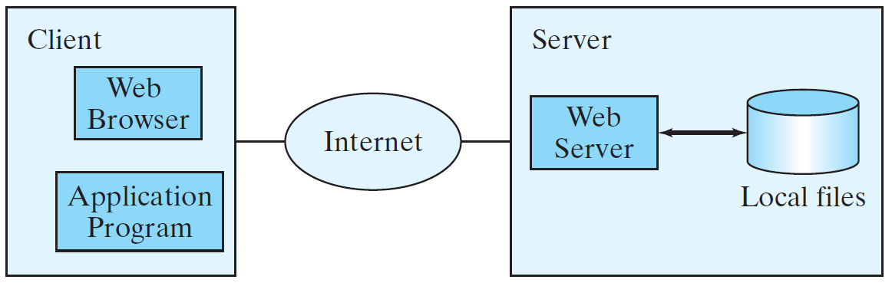
Reading Data from the Web
Just like you can read data from a file on your computer, you can read data from a file on the Web.

Slide 17
Reading Data from the Web
URL url = new URL("www.google.com/index.html");
After a URL object is created, you can use the openStream() method defined in the URL class to open an input stream and use this stream to create a Scanner object as follows:
Scanner input = new Scanner(url.openStream());
ReadFileFromURL
Run

Slide 18
Exercise
Write a program that read student’s score from an input file. This file contains the student name (in one line), student matric number, scores for first test (20%), second test (20%), lab assignment (20%) and final exam (40%). Your program need to find the total scores for each student and grade based on the total scores. Write in the output file the student name (in one line), matric number, total score and grade.

Slide 19
Summary
Read data from input file.
Process data.
Write results to output file.
Makes use of a computer’s ability to process large amounts of data quickly and reliably.

Slide 20
End of Chapter 6

